Slide 1

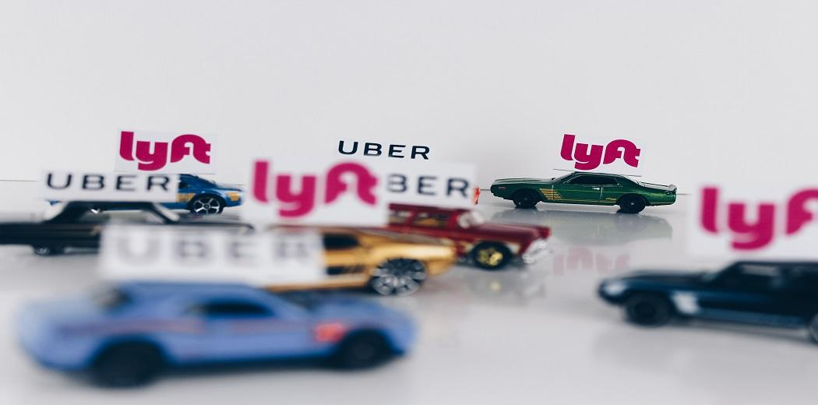
Lyft vs. Uber
— increasing Lyft’s market share
Dora Zhu

Slide 2
Table of contents
01.
Background Information
02.
Lyft & Uber Stock Analysis
03.
Time Analysis
04.
Destination Analysis
05.
Weather Analysis

Slide 3
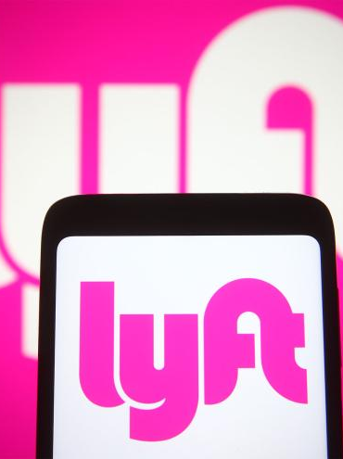
01.
Background Information

Slide 4
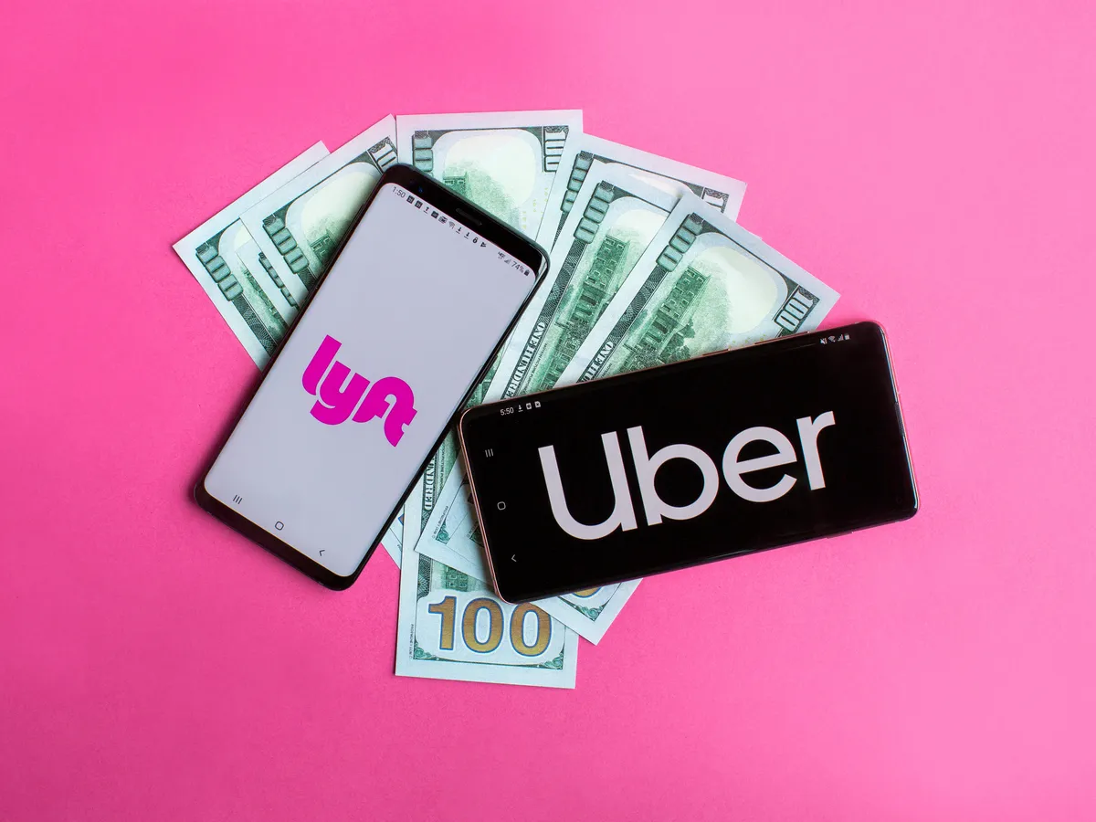
Dataset
We found the record dataset on Kaggle (https://www.kaggle.com/datasets/ravi72munde/uber-lyft-cab-prices?select=cab_rides.csv)
The dataset collects real-time price data in Boston, for a week in Nov - Dec 18 (collected at a regular interval of 5 mins) using Uber & Lyft api queries and indicates the corresponding weather conditions.
The original dataset contains 693071 rows and 57 columns of data. To process the data on Tableau more effectively, we decided to reduce the dataset to 100001 rows and 57 columns.
For the lyft stock dataset, we use GOOGLEFINANCE to gather =GOOGLEFINANCE("lyft","all","1/1/2019","12/31/2023","daily")
=GOOGLEFINANCE("uber",all","1/1/2019","12/31/2023","daily")

Slide 5
Project Design
Goal
Dimension
Lyft and Uber are two of the most popular ride-sharing services in the world, providing convenient and affordable transportation options for millions of users. However, Lyft only owns 32% of the market, compared with 68% market share owned by Uber.
Help Lyft gain more market share after analyzing the causes of difference
there are several differences between the two companies that can affect their performance. We will conduct analysis based on the following dimensions.
Lyft & Uber Stock Analysis
Time Analysis
Destination Analysis
Weather Analysis

Slide 6
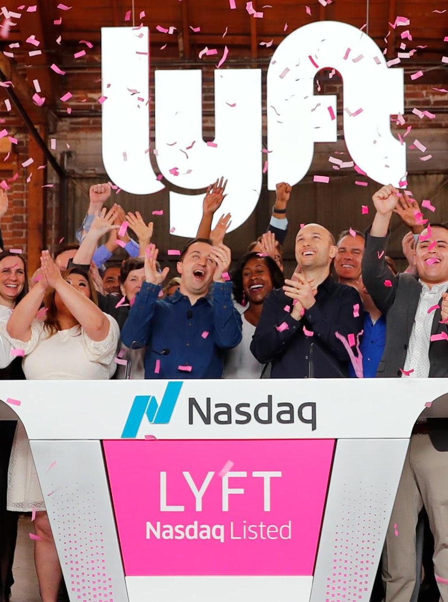
02.
Lyft & Uber
Stock Analysis
Although the record data we used was during Nov - Dec 18, we will use the newest stock data in 2022 -2023 for the Lyft & Uber stock analysis.

Slide 7
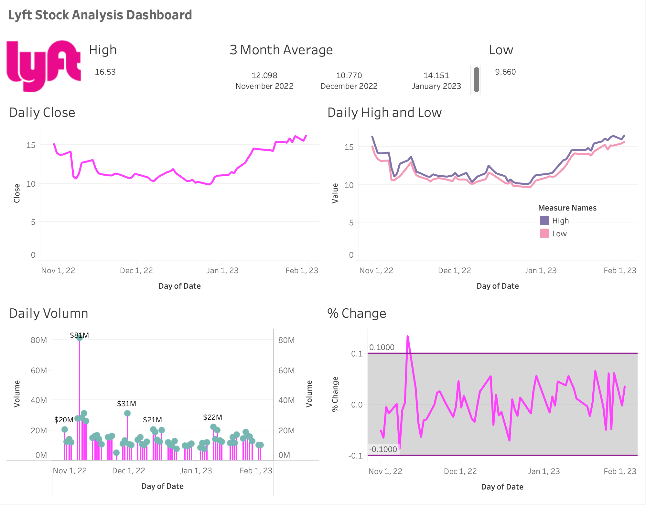
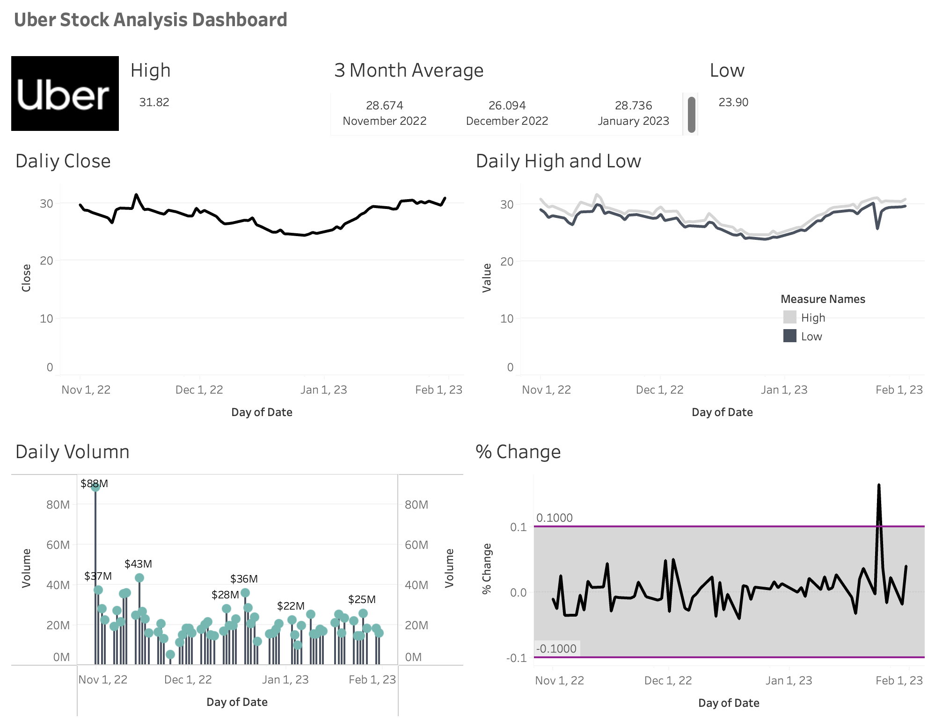
Lyft & Uber Stock Analysis
Overview
Lyft's stock price and daily trading volume are notably lower than that of Uber's
The percentage change of Lyft's stock price tends to fluctuate more frequently

Slide 8
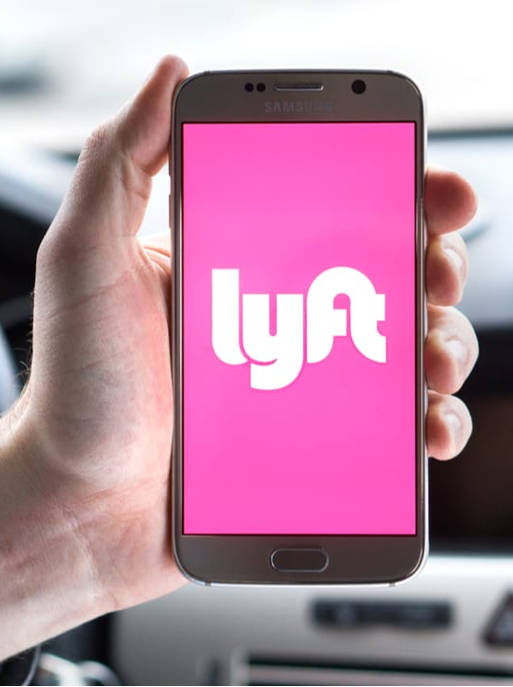
03.
Time Analysis
Lyft's prices are generally higher than Uber's among any time, which can affect its customer volume.

Slide 9
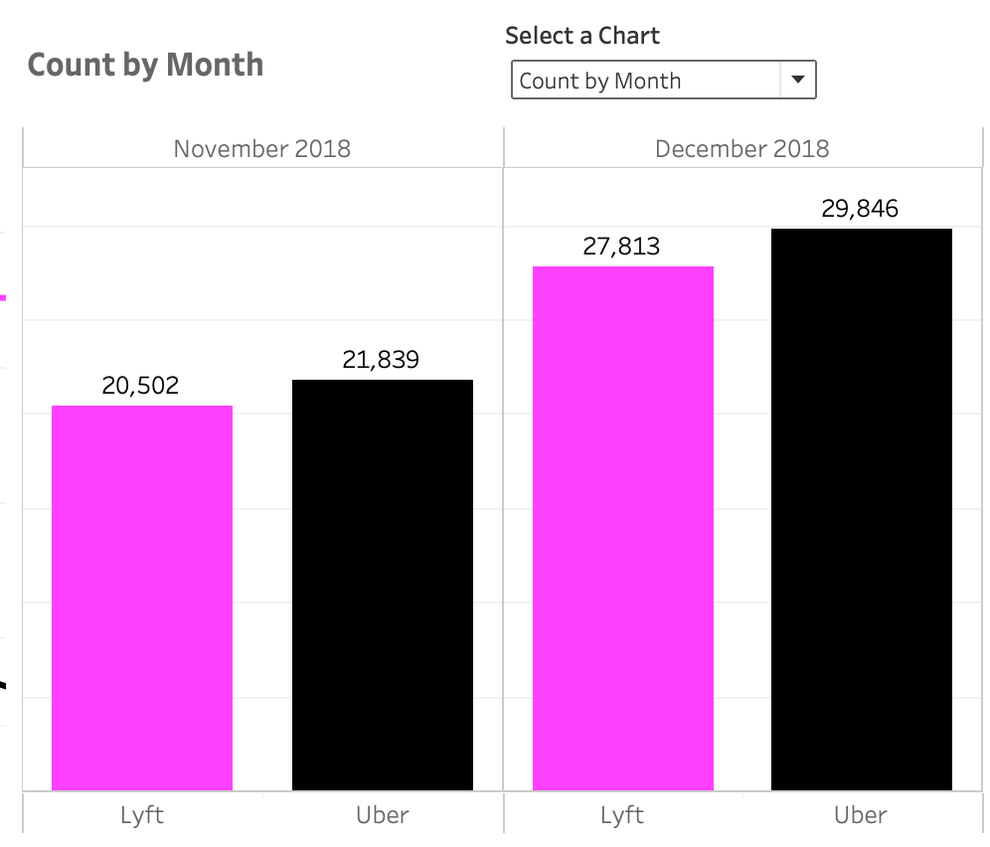
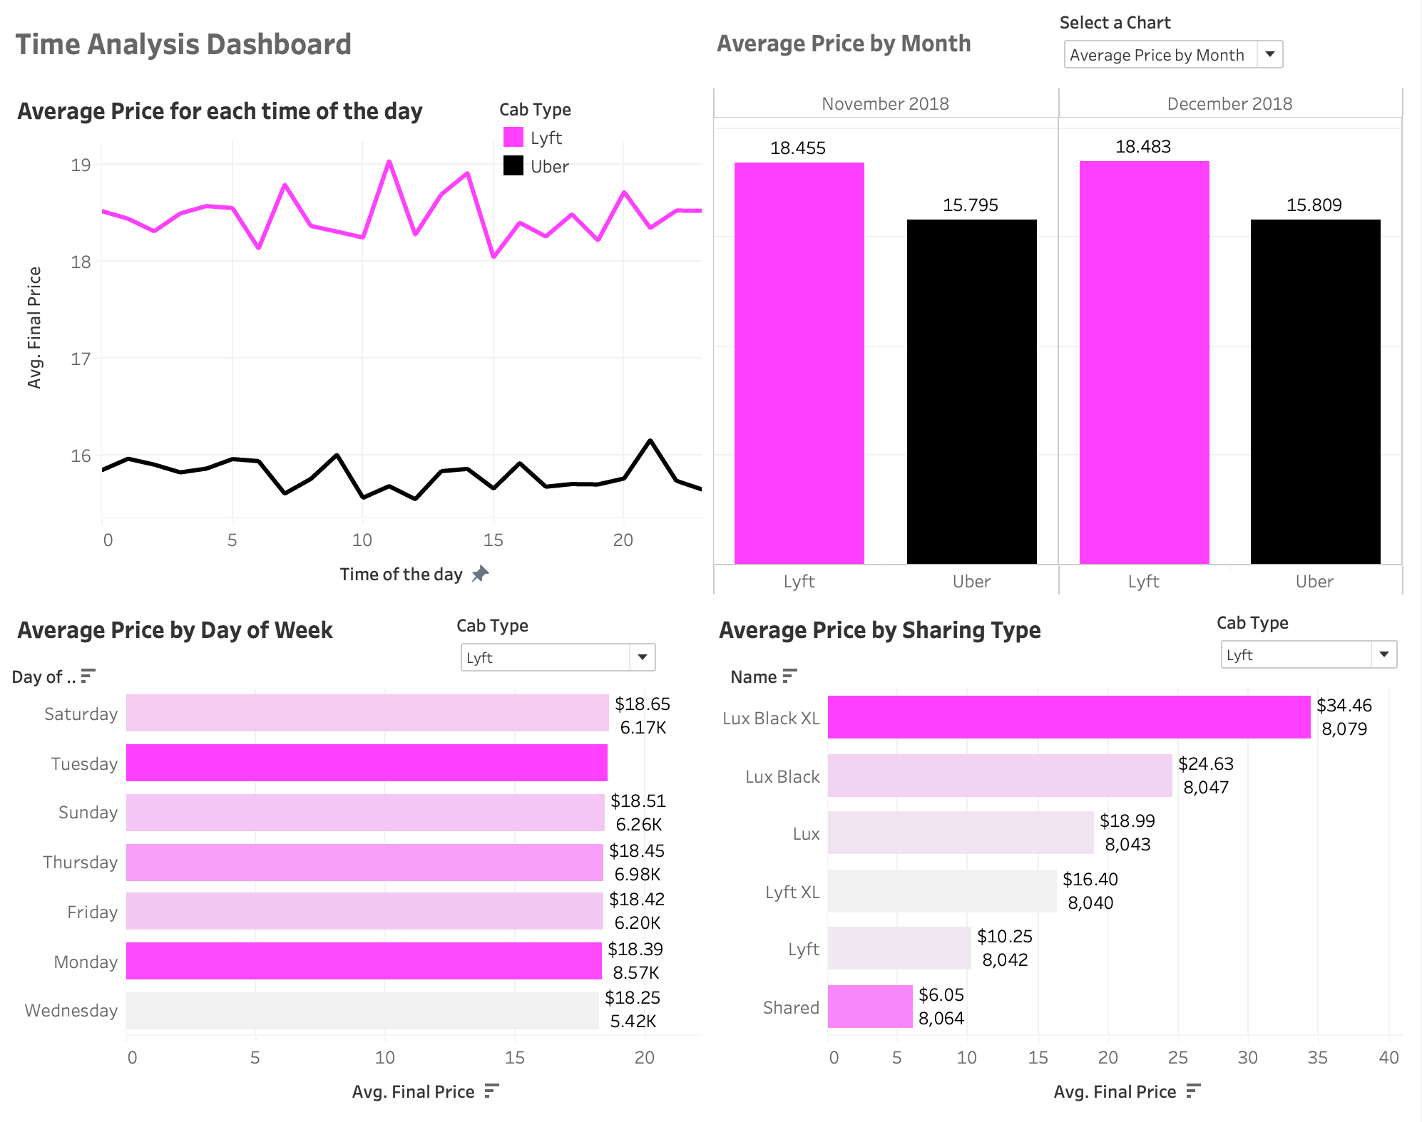
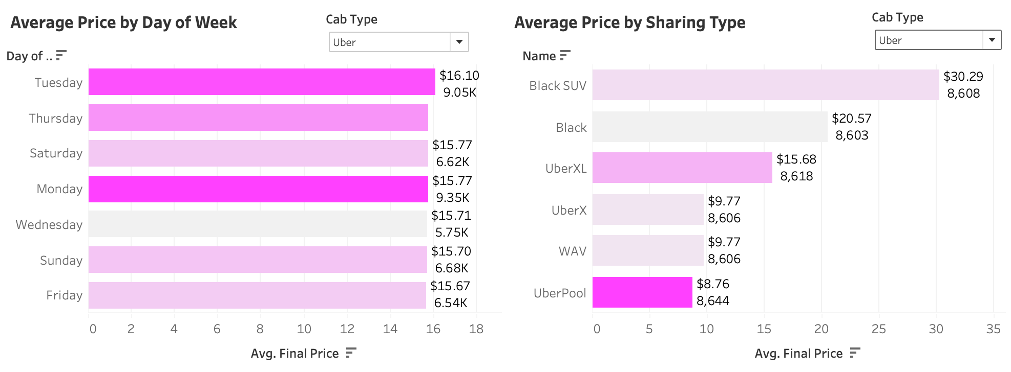
Time Analysis
Different views:
- Parameter
- Dashboard filter
Click on days in the graph‘ Average Price by Day of Week’, will get matching data for specific day in ‘Average Price for each time of the day’ & ‘Average Price by Sharing Type’
- Worksheet filter
Recommendations
Lyft may need to attract some new drivers to join in order to serve more users. In that case, average price may slightly become lower
Lyft can consider adjust its surge pricing model for better pricing strategies

Slide 10
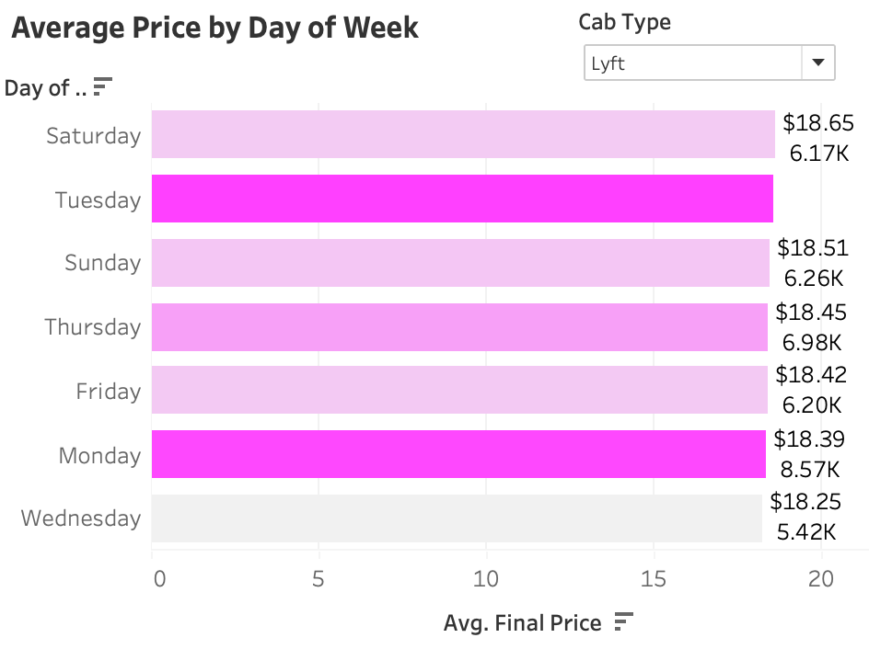
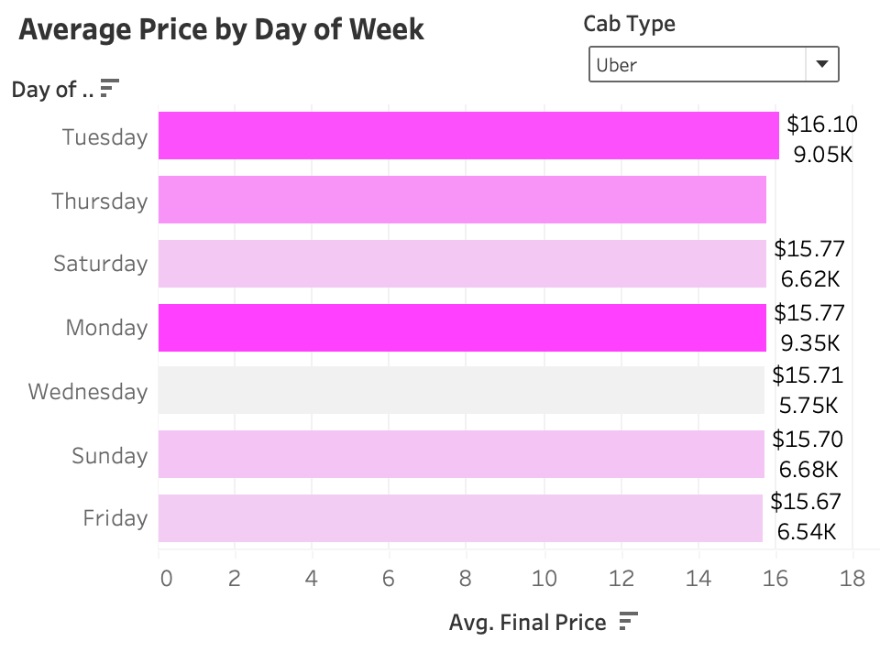
Time Analysis
Recommendations
Lyft may need to incentivize more drivers to work on weekends
On high customer volume days such as Tuesdays and Mondays, Lyft can consider implementing a slight price increase to balance out the lower prices offered on weekends

Slide 11

04.
Destination Analysis
Lyft's prices are most expensive when going to colleges, entertainment venues, and firms.

Slide 12
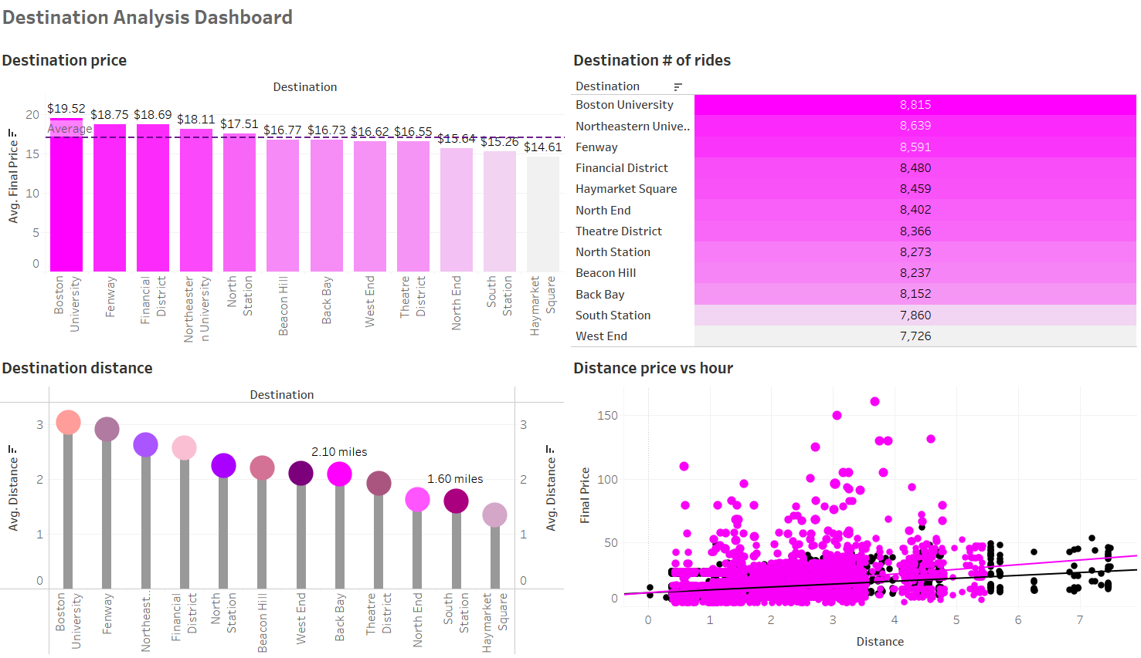
How does destination relate to price?
For the 12 different destinations in Boston: BU, NEU, Fenway, and Financial Districts indicate the highest price per ride, longest distance, and are the most frequently-visited places
From the scatterplot, we observe a positive relationship between distance and price during a selected time of the day; For the outliers, we find that most of them cluster between 2.5 and 4.5 miles, showing a higher possibility of increased surge multipliers for those distance ranges
Recommendations
We recommend Lyft to increase number of drivers in areas around schools, entertainment venues, and business firms
We recommend Lyft to increase number of drivers for shorter-distance rides

Slide 13
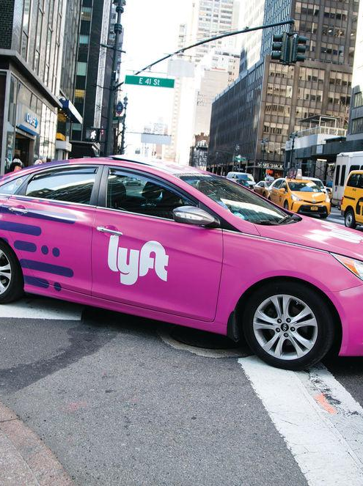
05.
Weather
Analysis

Slide 14
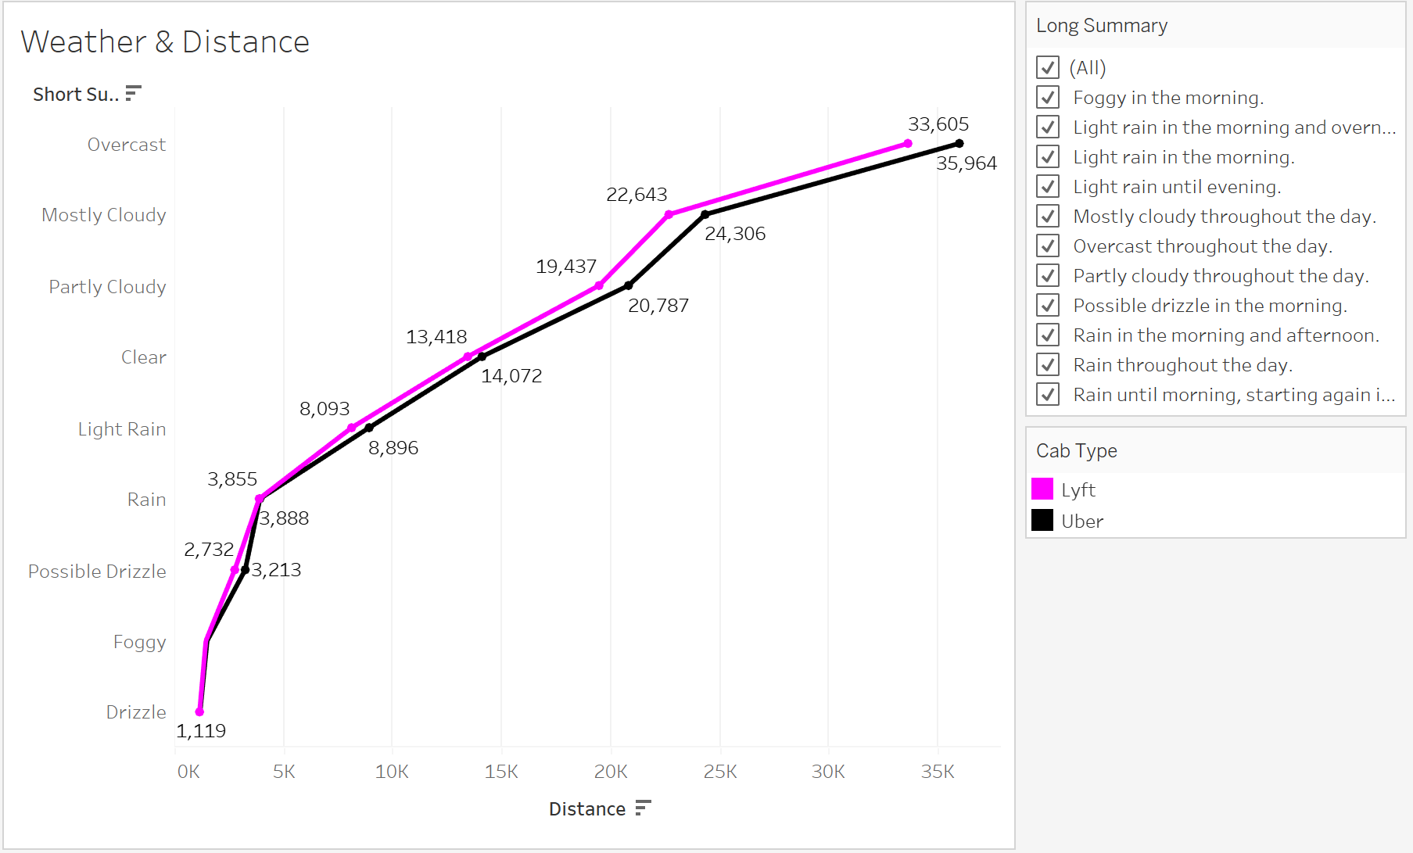
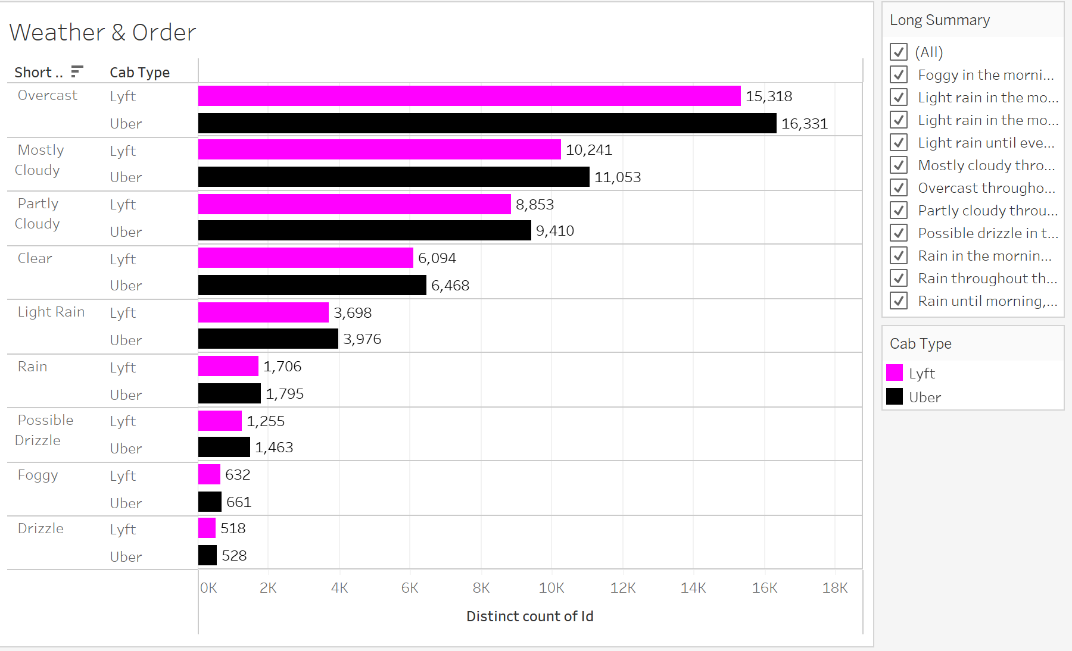
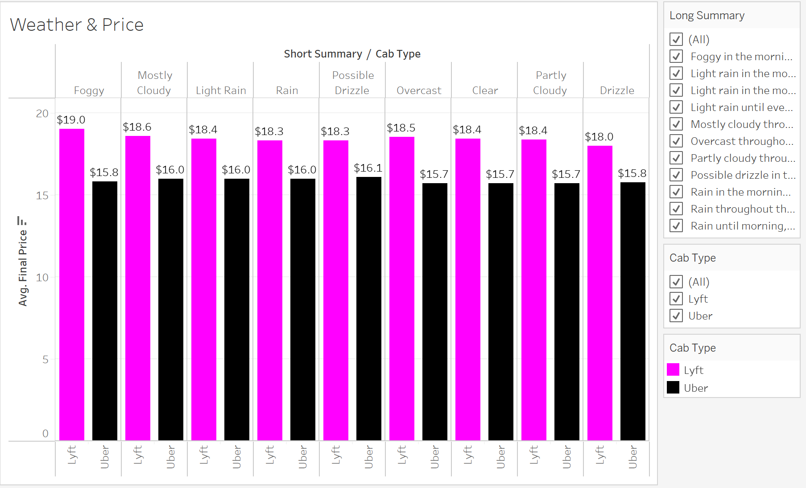
Weather Analysis
According to line graph and bar charts, Uber has higher operation distances than Lyft in all weather conditions. Then Lyft’s prices are higher than Uber’s in all weather conditions. The gaps reflect on number of orders: Uber receives more orders than Lyft in all weathers. The reason is obvious: Uber provides longer time of available rides in severe weather, and Uber’s service fee is lower.
Recommendations
The number of ride requests usually increase in bad weather conditions, so if Lyft hopes to enlarge business, Lyft should provide more available rides and lower price to attract customers

Slide 15

What We Recommend

Slide 16
How to expand Lyft’s market?
Time Analysis
Destination Analysis
Weather Analysis
Attract some new drivers to join in order to serve more users. In that case, average price may slightly become lower. Incentivize more drivers to work on weekends
Adjust its surge pricing model for better pricing strategies
On high customer volume days such as Tuesdays and Mondays, consider implementing a slight price increase to balance out the lower prices offered on weekends
Increase number of drivers in areas around schools, entertainment venues, and business firms
Increase number of drivers for shorter-distance rides
Provides more available rides and lower price to attract customers

